Slide 1
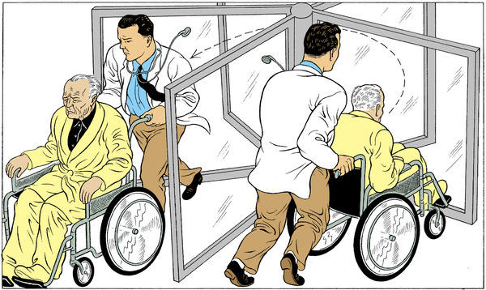
LASH – Slash 30 Days Unplanned Readmission Rate at Lakeside
Presented by: Kevin Watanabe-Smith
MEENAKSHI mISHRA

Slide 2

Rationale - Current readmission rate and impacts
LACE to LASH – Logic and Development
Implementation – Roles and Workflow
Notes:
Briefly introduce the concept
“Over the next 15 minutes I will introduce a risk score that will help us predict the risk of inpatient readmissions. I will lay out the need for change, introduce you to the model, and discuss how you will play a role in the success of this effort.”
I frequently see analysts spend too much time setting the stage and defining the need for change (next section). Do not fall into this trap. You will run out of time and lose your opportunity to explain the model and how it will help!

Slide 3

Why Change
Current status - 15% Readmission rate within 30 days
Cost and Workload
Identify patients who will benefit from preventative care or the high risk patients
Notes:
Spend a few minutes establishing a fact based need for change. Use existing organizational performance metrics, published studies, and current organizational problems to frame the need for change. Do not introduce editorial or build connections to the future yet. You are using facts to explain the current state.
Again, spending too much time justifying the need for change is the most common analyst presentation trap I witness! Your audience already knows the problems if they work inside the organization. Use this to pinpoint which specific pain points your model will help address.

Slide 4
Impact of not changing
Avoid CMS Penalty (Non-exempt hospital) - Meet 30-day risk-standardized unplanned readmission measures "Hospitals with more unplanned readmissions than expected will receive a reduction in each Medicare case reimbursement for the upcoming fiscal year that runs from Oct. 1 through September...."(khn.org)
Loss of opportunity to intervene and improve health outcomes for high risk patients
Notes:
Build the connection between inaction and the future state with a focus on building the emotional need for change. Connect current problems to likely / plausible future consequences.

Slide 5
LASH from LACE
LACE as a starting point
Readmission Prediction Index for 30 days readmission rates - Est. 2010 (Walraven in Montreal)
Well tested, validated and implemented at Kaiser Permanente sites in CA and OR
Can we simplify and improve the model for our patients?
Data sources –34,532 patients admitted to Lakeside hospitals in January 2014
Diagnosis and hospitalization history (patient and administrative level data)
Regression to identify factors predicting readmission
80% training, 20% testing
Comparison against Traditional LACE
Notes:
Spend time explaining the key components and functions of your model.
It is important that your audience understand the sources of data, calculations, and logic. Using organizational examples and organizational data works better than “dummy data” and pure mathematical calculations.
Think of this section as 25% sales pitch, 25% audience confidence building, and 50% end user training.

Slide 6
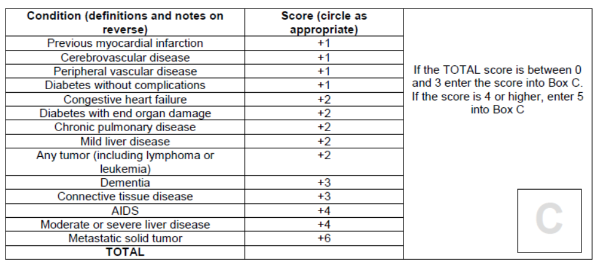
Traditional LACE
Length (days) | Score
1 | 1
2 | 2
3 | 3
4-6 | 4
7-13 | 5
14+ | 7
L
A
C
E
Length of stay
Acuity = 3 points If admitted through ED
Comorbidities = Determine history and weight for 14 different comorbidities. If greater than 4, round to 5.
Emergency visits = How many ED visits in past six months, not counting this one. 1 point per visit (max 4)
LACE of 11+ predicts high risk patients
Notes:
Spend time explaining the key components and functions of your model.
It is important that your audience understand the sources of data, calculations, and logic. Using organizational examples and organizational data works better than “dummy data” and pure mathematical calculations.
Think of this section as 25% sales pitch, 25% audience confidence building, and 50% end user training.

Slide 7
Simplified LASH
Length (days) | Score
1 | 1
2 | 2
3 | 3
4-6 | 4
7-13 | 5
14+ | 7
L
A
S
H
Length of stay
Acuity = 3 points If admitted through ED
Stroke = 1 point if patient has a history of stroke
Heart Attack = 1 point if patient has a history of heart attack
LASH of 7+ predicts high risk patients
Notes:
Spend time explaining the key components and functions of your model.
It is important that your audience understand the sources of data, calculations, and logic. Using organizational examples and organizational data works better than “dummy data” and pure mathematical calculations.
Think of this section as 25% sales pitch, 25% audience confidence building, and 50% end user training.

Slide 8
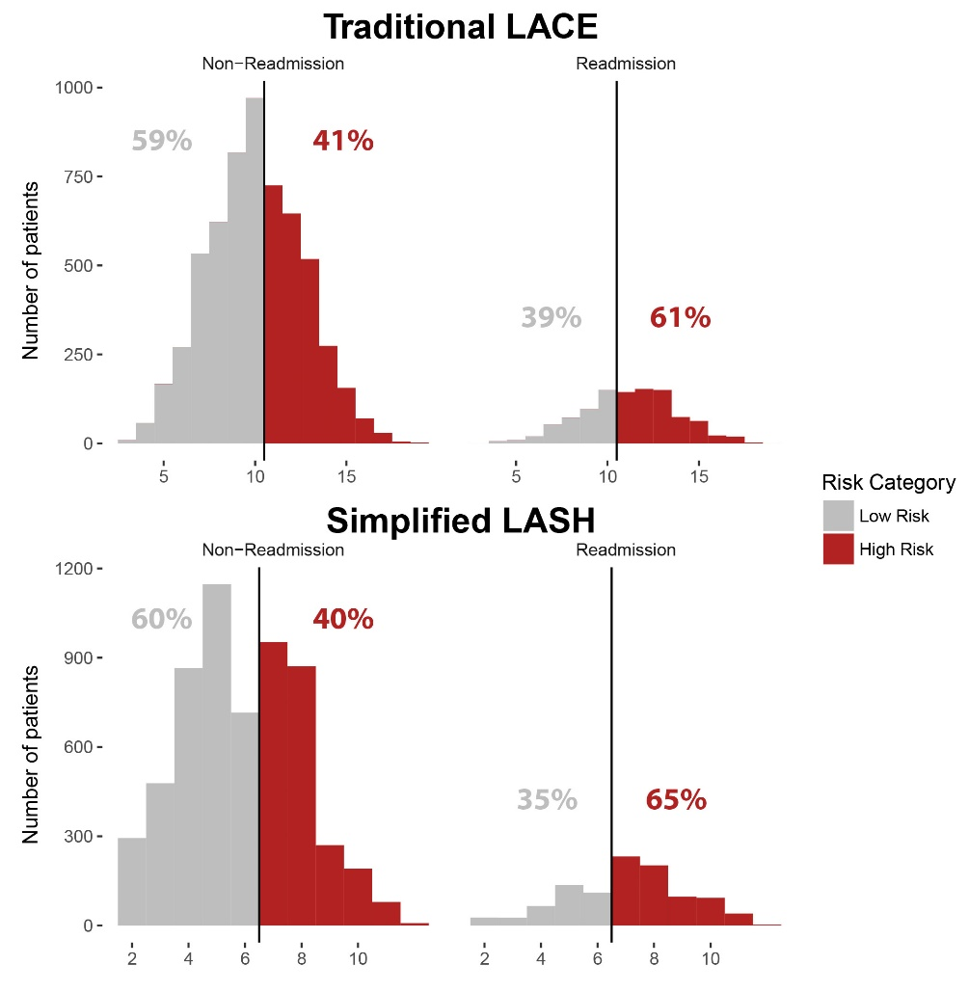
LASH selectively identifies at-risk patients
Notes:
Spend time explaining the key components and functions of your model.
It is important that your audience understand the sources of data, calculations, and logic. Using organizational examples and organizational data works better than “dummy data” and pure mathematical calculations.
Think of this section as 25% sales pitch, 25% audience confidence building, and 50% end user training.

Slide 9
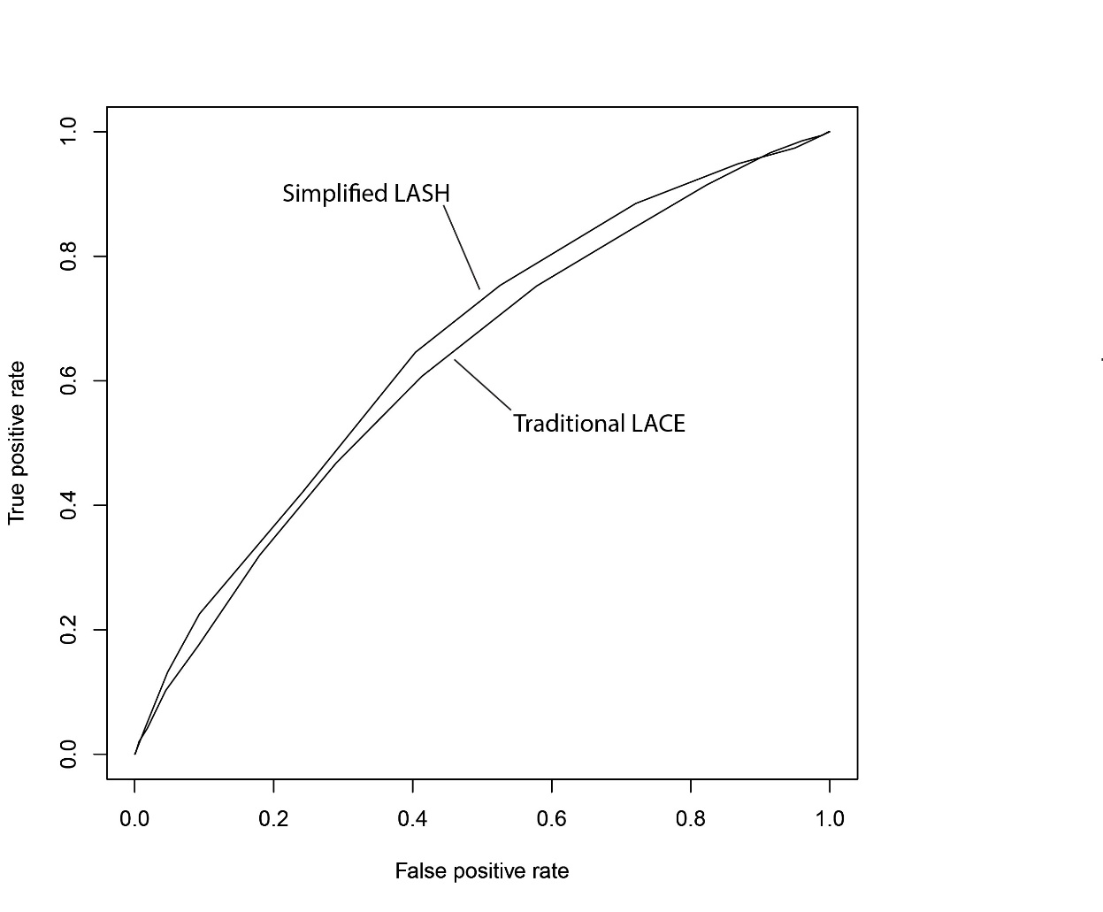
LASH as a superior model
Model | Readmissions Predicted | Total Interventions | Predictive Rate
LACE 11+ | 627 | 3053 | 20.5%
LASH 7+ | 667 | 3039 | 21.9%
Notes:
Spend time explaining the key components and functions of your model.
It is important that your audience understand the sources of data, calculations, and logic. Using organizational examples and organizational data works better than “dummy data” and pure mathematical calculations.
Think of this section as 25% sales pitch, 25% audience confidence building, and 50% end user training.

Slide 10
LASH integration in patient care
This index can be used with both primary and administrative data
L and A scores calculated and updated in patient summary screen within 2 days of hospital admit
Accessed by discharge nurse when the discharge planning starts
Patients with a LASH 7+ will be flagged as high-risk in EPIC at discharge
Nurse follow-up call in 24-48 hours
Scheduled for visit to primary care physician within 5 days
Notes:
Reconsider intervention strategy in 3-6 months post-implementation

Slide 11
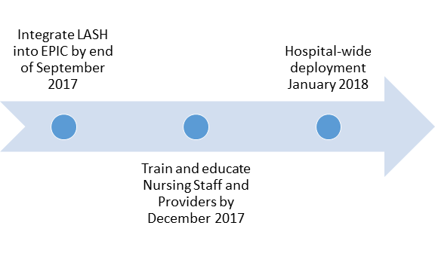
TIMELINE
Notes:
End with action!
Specifically detail what you need your audience to do in order to make this effort a success.
Think of this as the positive benefits that offset the negative consequences you highlight earlier.
Leave your audience with a clear sense of what they need to do individually to drive success when the leave the room.

Slide 12
Institutional Commitment to deployment
Introduction to LASH at each department
Identify LASH champion at each department
Integration of LASH into nurse’s training and continuing education

Slide 13
The Future
Benefits to Kaiser-Permanente
Currently 15% of our patients are readmitted
LASH will identify majority of these patients (65%)
Tracking readmission rates over next quarter
Goal: 33% reduction in readmission rates (from 15% to 10%)
Rapid return on investment within one quarter
Highly sustainable with annual review of model and intervention strategy
Notes:
End with action!
Specifically detail what you need your audience to do in order to make this effort a success.
Think of this as the positive benefits that offset the negative consequences you highlight earlier.
Leave your audience with a clear sense of what they need to do individually to drive success when the leave the room.

Slide 14
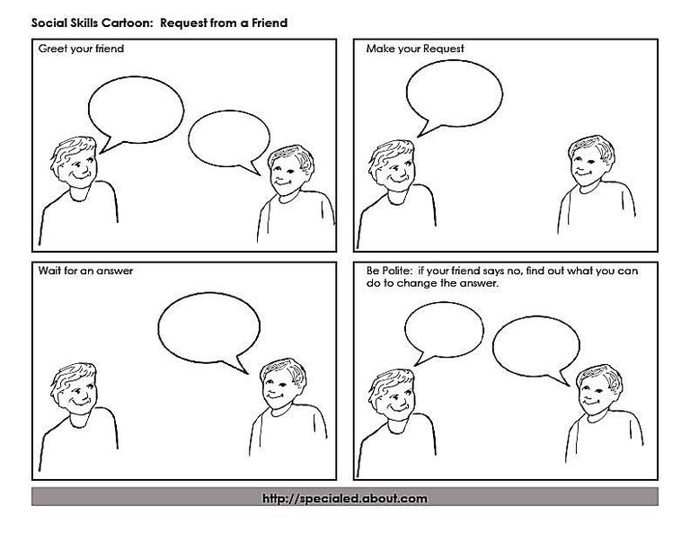
Questions?

